Slide 1
Translation as a Business
The Importance of Information & Communication in the Localization Industry
Annette Hemera
Annette Hemera Consulting Ltd.
INFuture 2011 – November 9 – 11, Zagreb

Slide 2
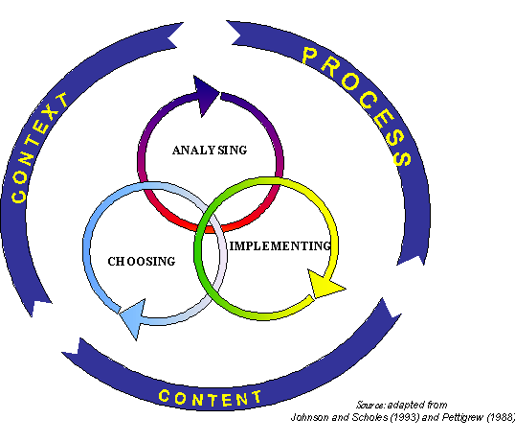
The Neverending Learning Curve
11/9/2011
Annette Hemera Consulting
2

Slide 3
„Translation is a job with future…”
According to a study on the language industry translation is a job with a future.
It is a job in constant evolution involving subtitling, localizing, editing, web editing etc. It may also entail other competences, such as project management, marketing, customer relations, time and budget management, negotiation with clients just to name just a few.
Translators need to acquire language and intercultural competences. They need technological competence and thematic competence
Leonard Orban, Commissioner for Multilingualism
European Commission, 2009, Brussels

Slide 4
„Localization is a job with future”
Localization is the process of adapting different documentations for non-native environments especially other nations and cultures

Slide 5
The Localization Market - a few quick facts
A constantly growing market – 12 billion USD in 2010
Due to the Internet and other applied technologies country boarders disappeared – only one global market
Endless technological innovation - an urging need of cost reduction and efficiency. Pricing issues, price wars
Growing importance of MT and automation BUT human contribution will always be needed
Employers prefer to hire candidates with a combination of formal training and (3-5 years) work experience

Slide 6
The Localization Market - a few quick facts
Due to the growing importance of CAT tools the translation workflow and the key roles at localization agencies have completely changed
Vendor managers
Engineers
DPT publishers
QA professionals
Linguists (translators, proofreaders)
Terminologists
Project managers

Slide 7
The Localization Market - A Few Quick Facts
The value chain is getting more and more detailed and sophisticated
Growing importance of QA and measurement of efficiency, precise statistics
Too many players between freelancers and end clients (high cost, low quality, decreasing efficiency)

Slide 8
The Localization Market - A Few Quick Facts
The life cycle of localization entered into the „mature” phase – in order to stay in competition vendors must differentiate themselves
A virtual localization market – virtual job portals, online databases and TMs - anyone can work for anyone from anywhere

Slide 9
The Localization Market - A Few Quick Facts
Huge competition with lot of business opportunities
Specialization and superior knowledge of technologies (CAT tools etc.) is key for success
FIGS languages – still the most selling ones

Slide 10
Are Translation Education Institutes and Other Industry Stakeholders Prepared for Such Challenges?

Slide 11
The Importance of Market Analysis
„At the end of the report it is proposed that
XY COMPANY uses its existing and well working methodology of recruiting and evaluating in-country linguistic resources and fit the current method to the CEE market characteristics and client needs
XY COMPANY revisits its existing Value Chain and adjust it to CEE market characteristics and needs in order to get more competitive in terms of project management, availability, turnoraound times and quality
XY COMPANY creates and maintains a timely and accurate market information system where CEE market and marketing information is formally gathered, sorted, analyzed, evaluated and distributed to the decision makers on a continuous basis
XY COMPANY leverage the market and industry related knowledge and experience of local BDMs, creates and maintains a structured, well organised and interactive communication between its headquarters and the local salesforce”
11/9/2011
Annette Hemera Consulting
11

Slide 12
The Translation Education – The Way It Looks from the Outside
An underfunded translation education
Very often translation courses are not planned according to the actual market needs (language pairs, subject field, required technologies)
Trainings of technologies without suitable computer and software background and w/o practical experience by the tutors
Translation as a profession is not very well respected and in general not very well paid either
Lack of communication and cooperation there is a huge vacuum between demand and supply

Slide 13
Areas That Might Need Improvement
Spreading the knowledge on
How translation companies work
How freelancers can get listed in vendor databases
How to manage the translation workflow
How to become a successful entrepreneur (business management)
Creating well maintained and informative databases with job opportunities, translator profiles and knowledge bases
Involving practicing localization professionals in translation education
Internship programs (national and worldwide)

Slide 14
Areas That Might Need Improvement
Enhancing communication and cooperation between the industry players
translation education representatives
freelancers
language service providers (MLVs and SLVs)
end clients
authorities
associations
end users of localized documents
Freelancers need to change their attitude and become proactive entrepreneurs
Translation courses might be revisited and additional programs (e.g. PM, work-flow management, vendor management etc.) could be introduced

Slide 15
The Neverending Learning Curve

Slide 16
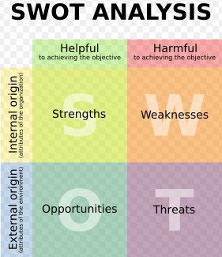
Understanding our Business Potentials

Slide 17
Understanding our Internal Environment
STEP Analysis
Social
Technological
Economic
Political
11/9/2011
Annette Hemera Consulting
17

Slide 18
Understanding Our External Environment - The “Playground Analysis”
SUPPLIERS
Bargaining power of vendors
Industry rivalry
POTENTIAL
ENTRANTS
SUBSTITUTES
Threat by
new
entrants
Competition among existing players
Threat by
substitutes
Bargaining power of clients
(Porter, Five Forces Model
1980)
BUYERS

Slide 19
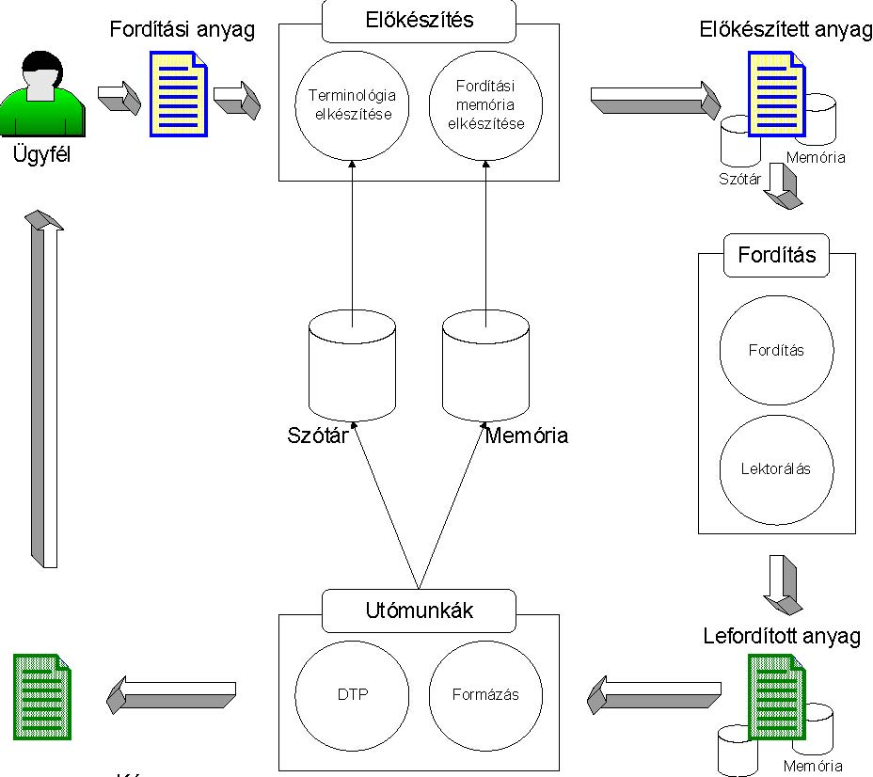
Understanding The Product - The Localization Workflow
The Localization workflow
Request and approve quote
Review and approve of glossaries
Review sample translation
Review final translation

Slide 20
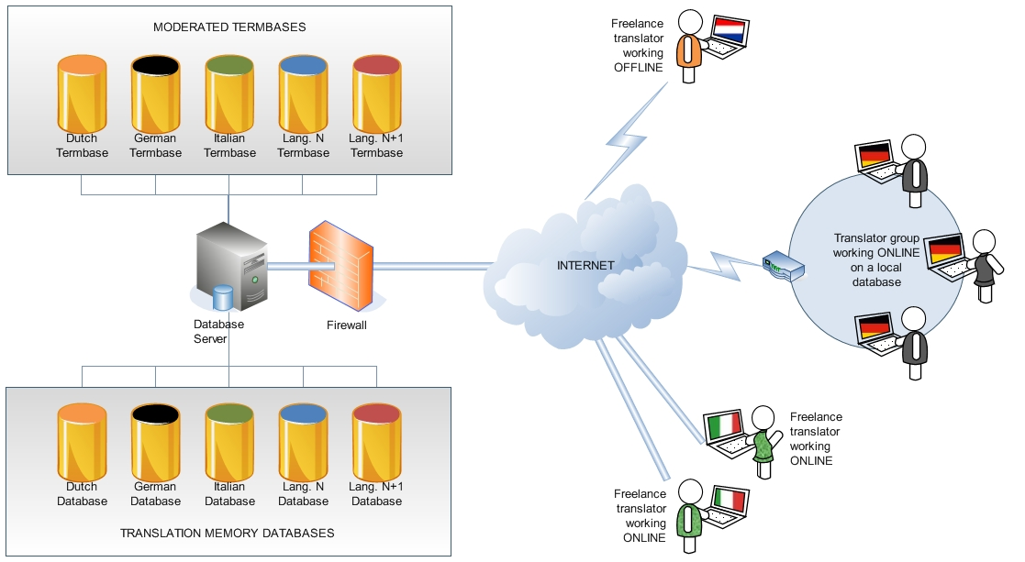
Understanding the Technology
11/9/2011
Annette Hemera Consulting
20

Slide 21
Understanding our Processes – The Value Chain Analysis
SUPPORT ACTIVITIES
FIRM INFRASTRUCTURE – a financially strong and successful global company with solid and well working systems and processes
HUMAN RESOURCE MANAGEMENT – motivating and professional working environment
TECHNOLOGY DEVELOPMENT: CSOFT is a trend setter and market leader of localization technologies
PRIMARY ACTIVITIES
Inbound Operations Outbound Marketing & Service
logistics logistics Sales
Vendor Production and
Management Project Management
marketing materials and communication tailor made to the CEE markets
Save cost by defining redundancies
Make production and PM available set to the time zone of the client
Annette Hemera Consulting
21

Slide 22
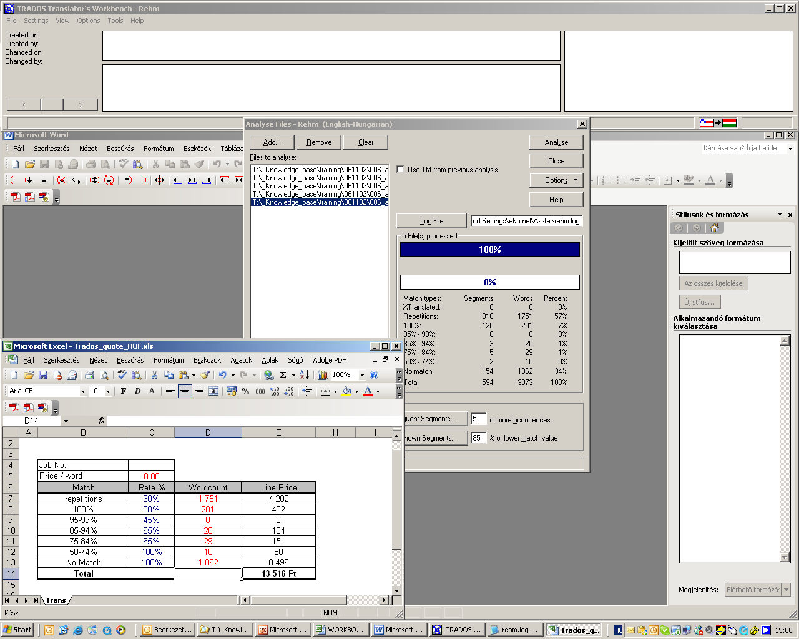
Understanding The Processes - Budgeting
Copyright © 2011 by CSOFT International, Ltd.

Slide 23
Summary – how to proceed
Ongoing analysis of the environment, revisiting and updating existing strategies
Strengthening the communication between the different stakeholders
Define key localization roles and adjust tranlslation trainings accordingly
Creating strategic alliances between stakeholders (vertical and horisontal)
Introducting new courses to the existing programs
11/9/2011
Annette Hemera Consulting
23

Slide 24
Thank you for your attention info@annettehemera.com

